Slide 1
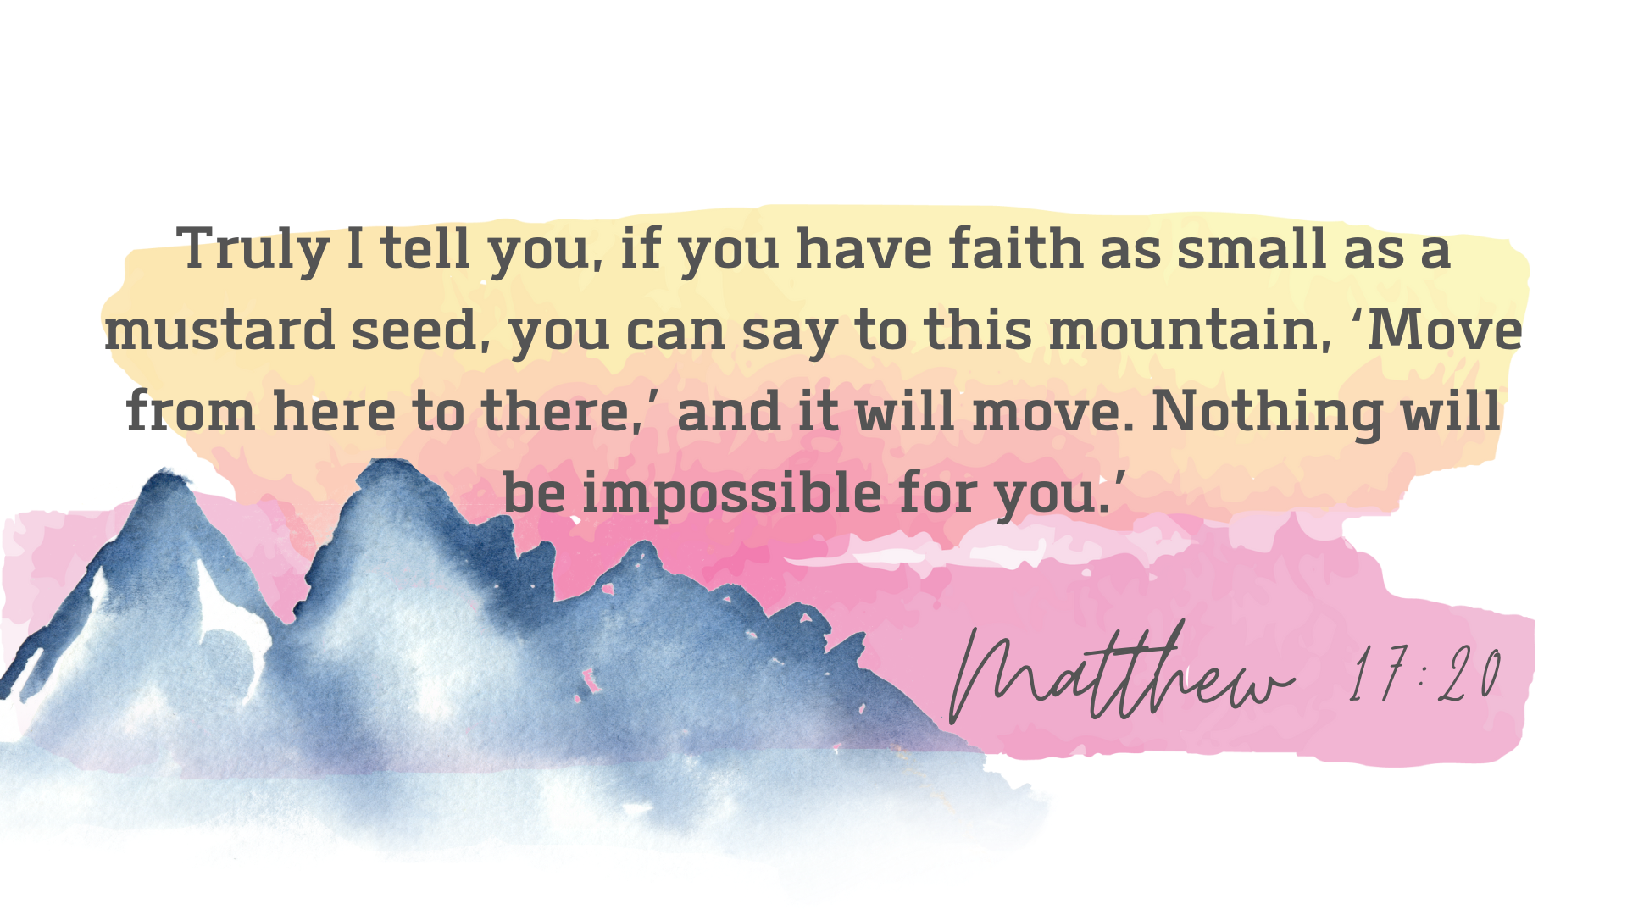


Slide 2
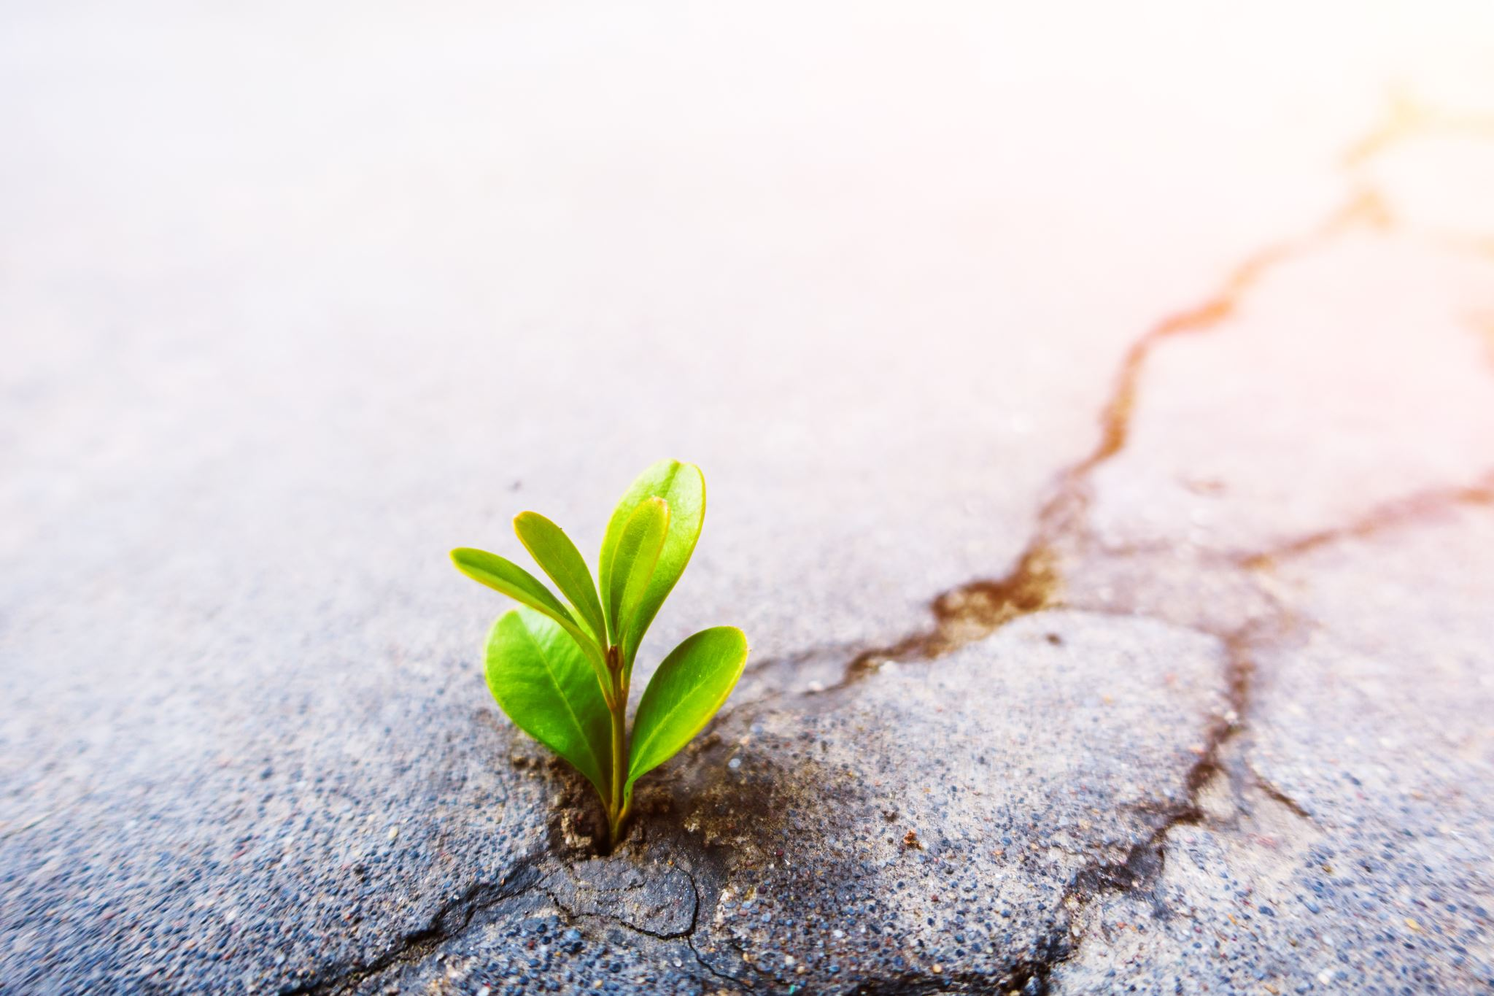
4.) Enrichment
This quality is concerned with ensuring pupils achieve well and that their progress in the subject is appropriate to their ages and circumstances

Slide 3
4.1 How good is the relationship between history and the rest of the school curriculum?
We are continuously forward thinking and making links with other subjects.

Slide 4
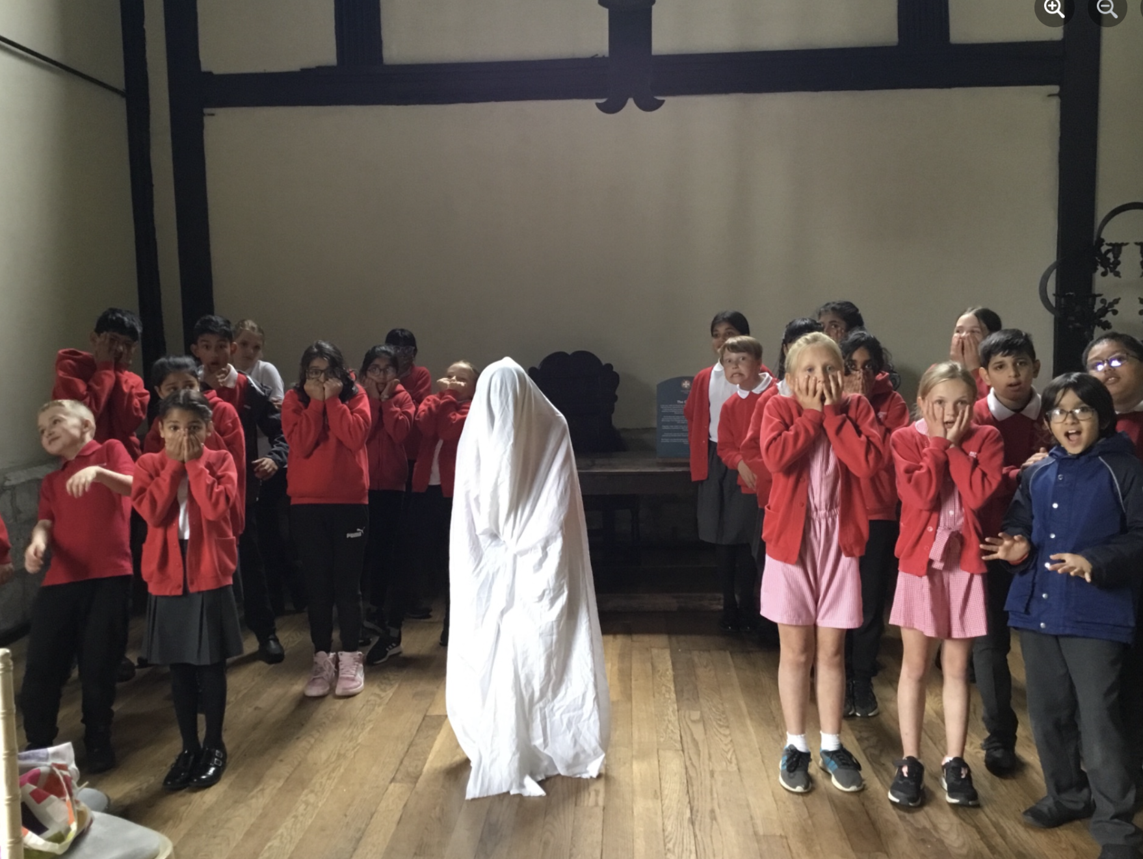
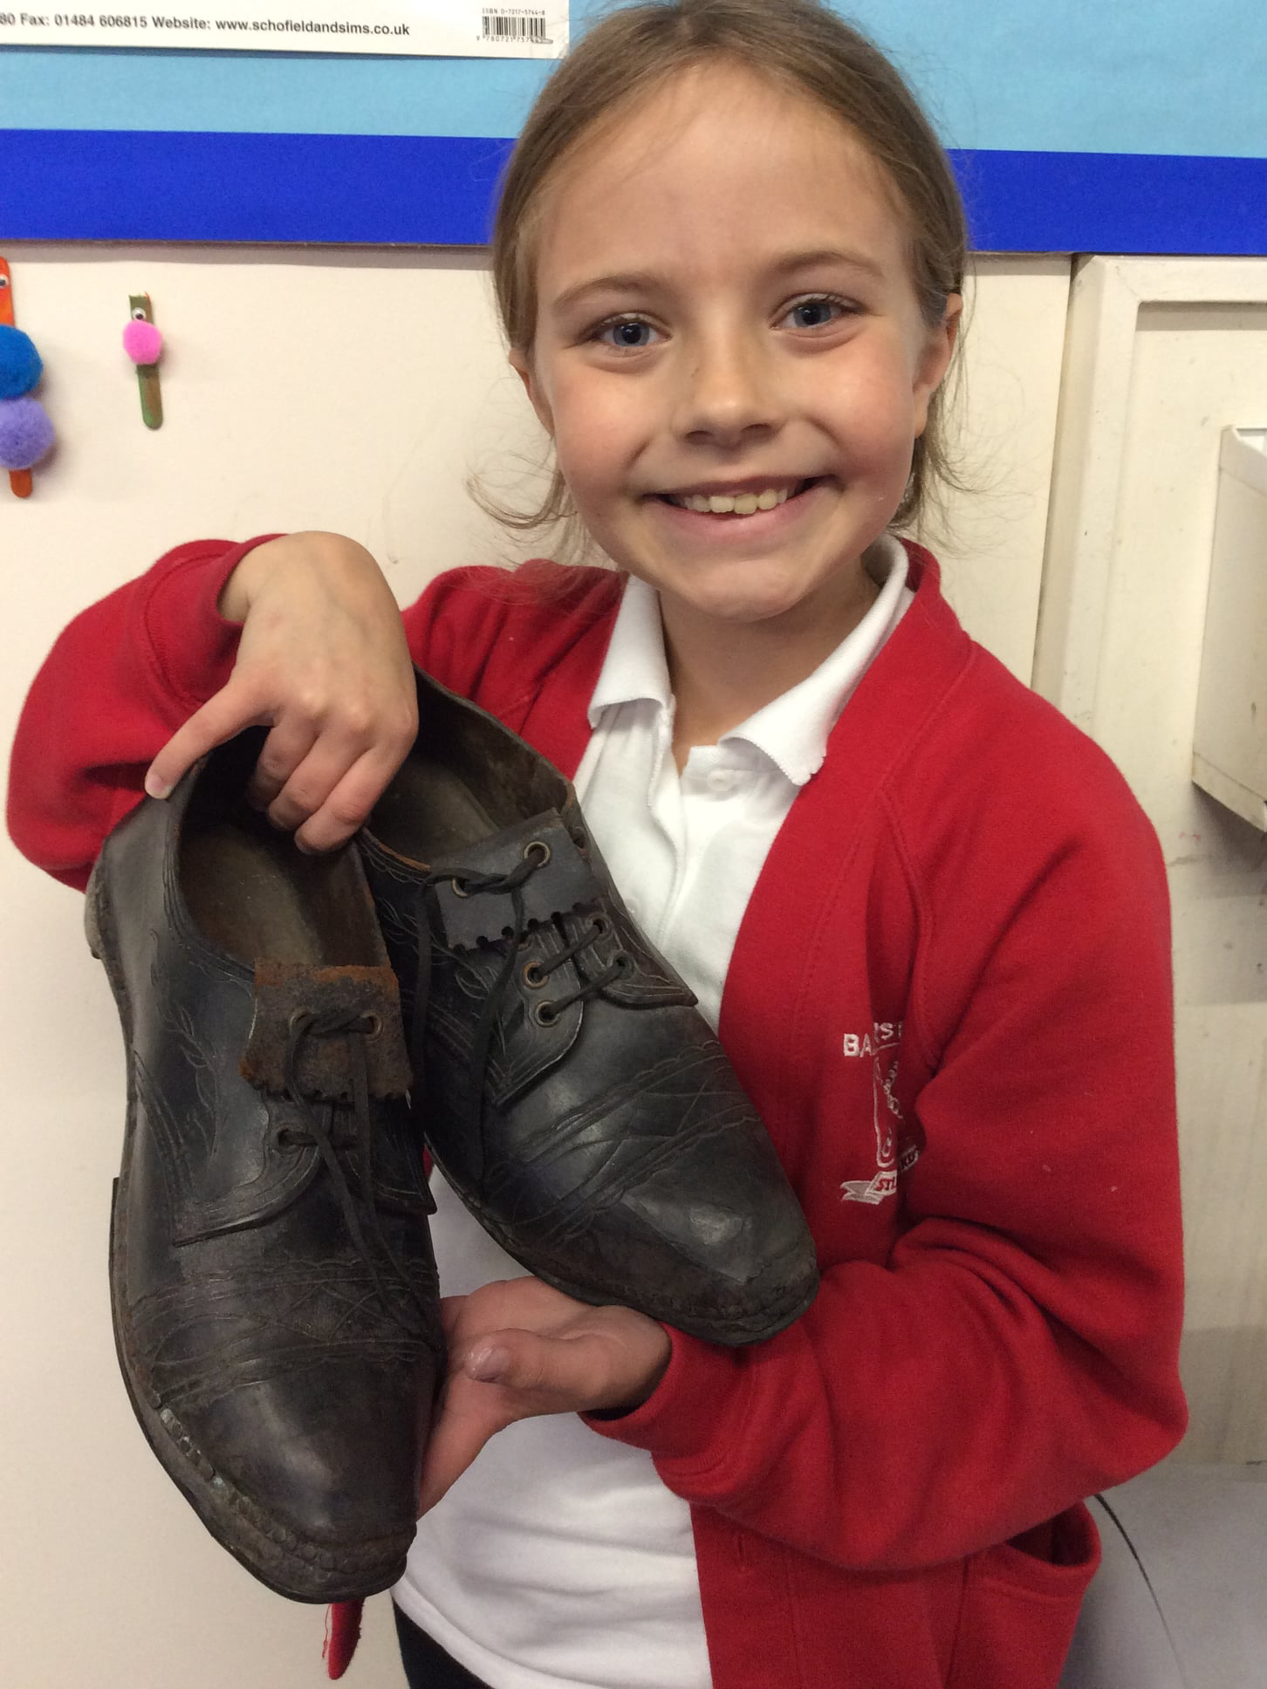
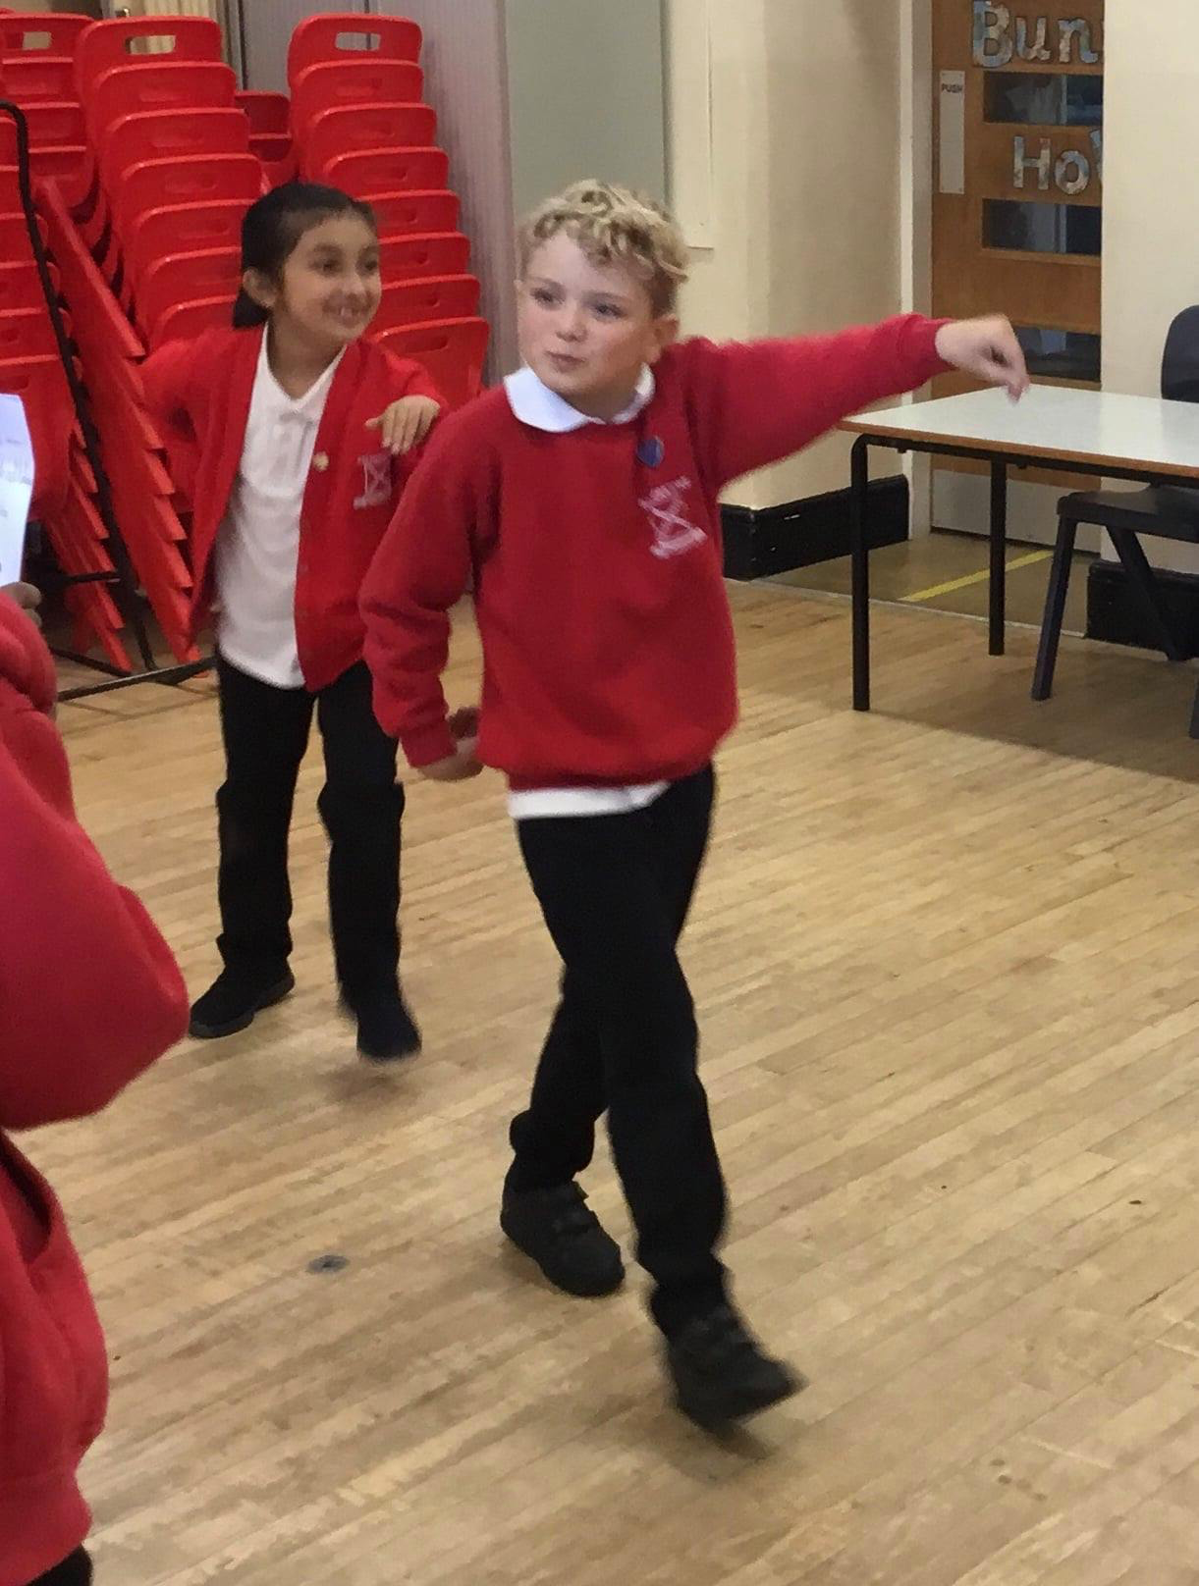
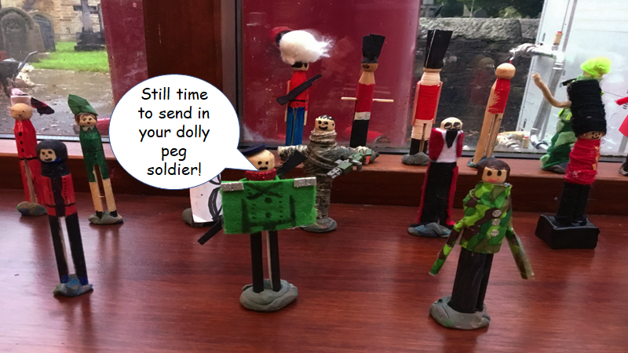
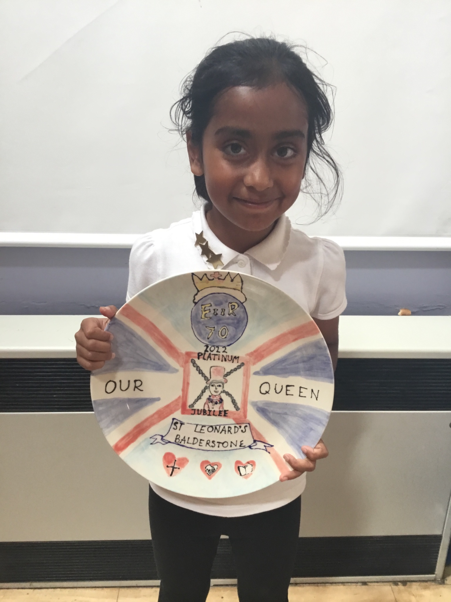
Drama- oral storytelling through English
Bringing resources in and talking about them on our podcast.
Egyptian dance
Whole school history art

Slide 5
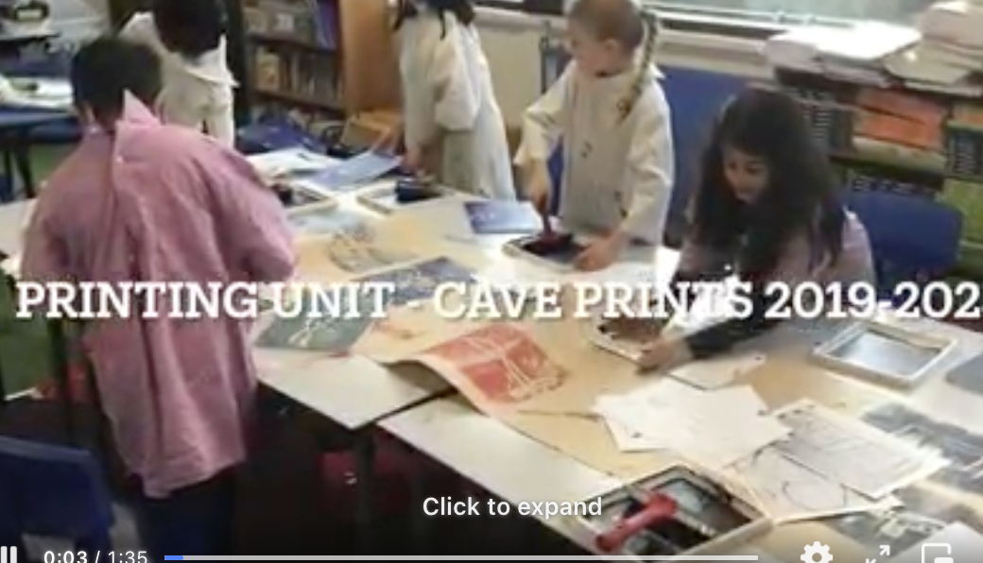
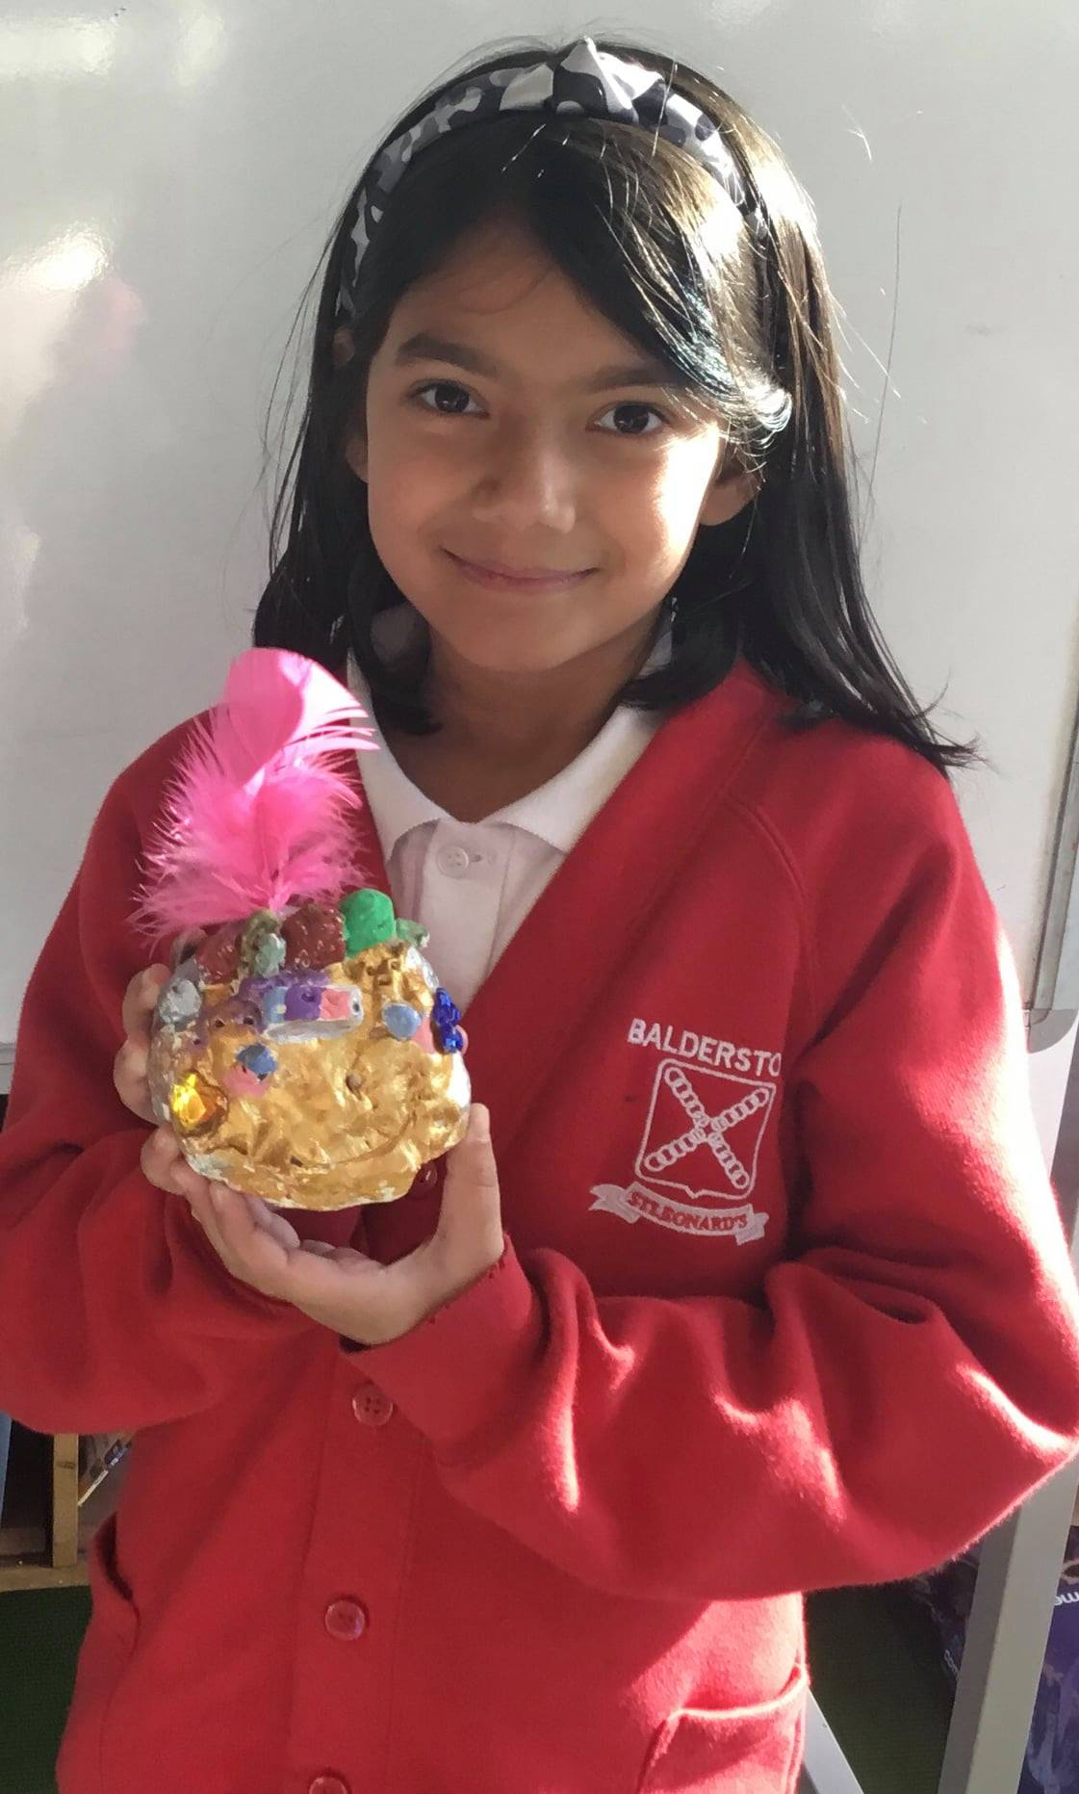
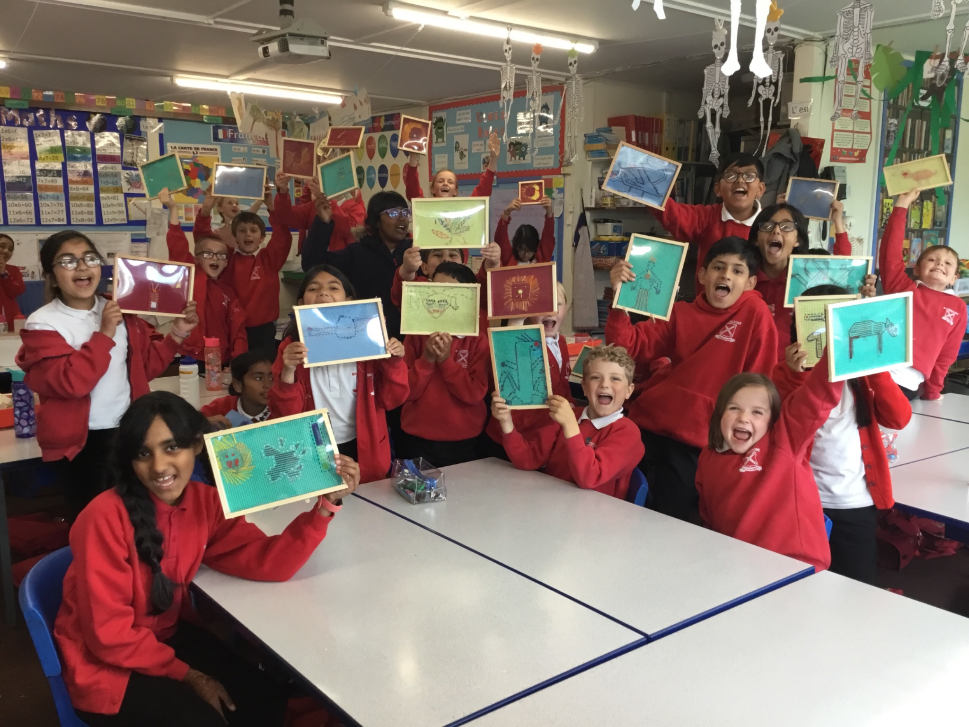
Clay focus – Egyptian art
Sewing Greek images from Hercules

Slide 6
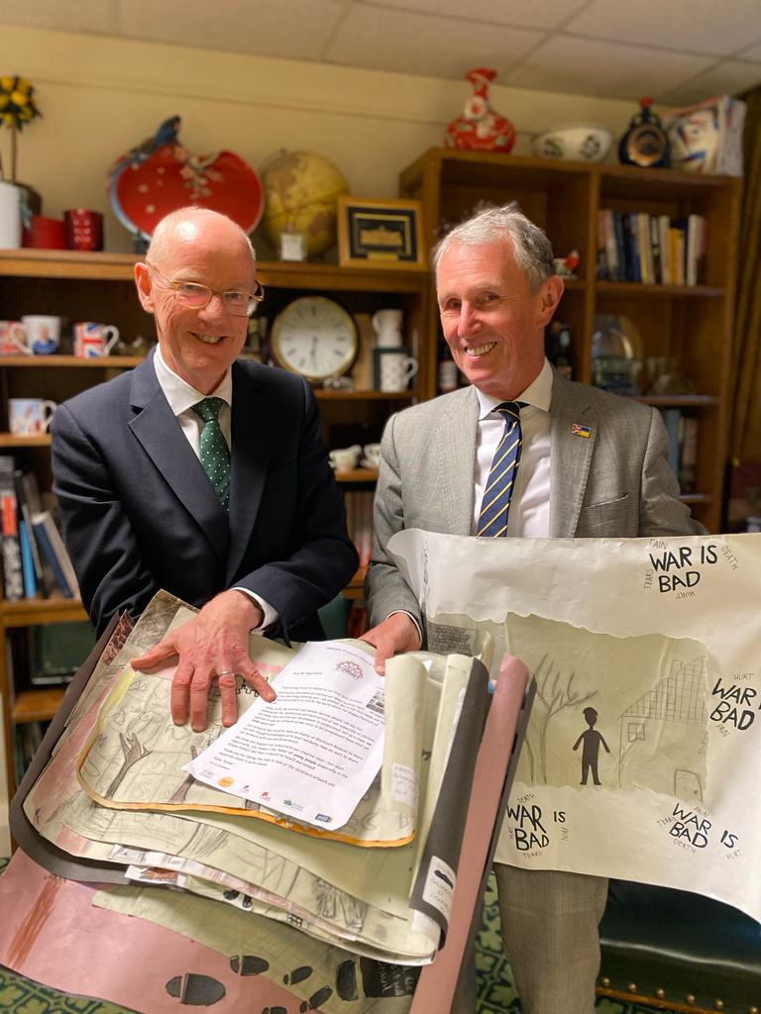
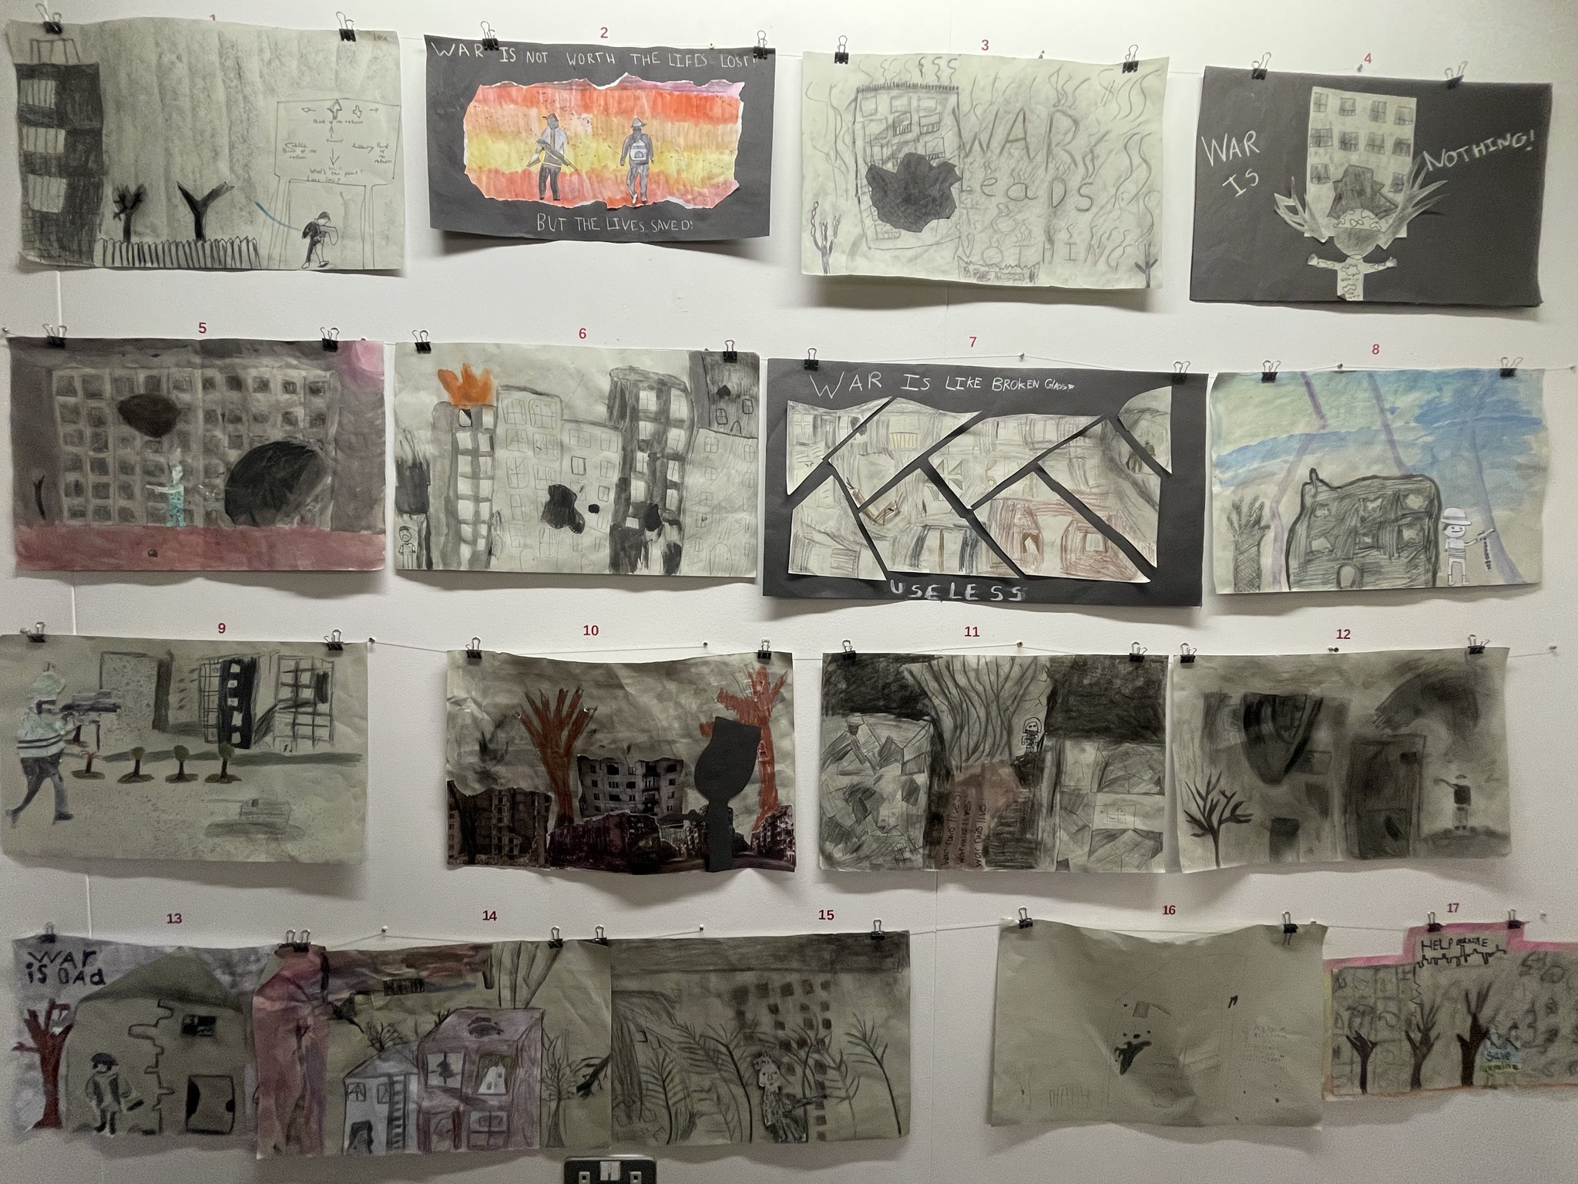
Our Year 5/6 war artwork was inspired by Paul Nash – it was on display at Blackburn Museum and we wrote to our local MP – explaining the importance of youth voice and how we need to learn from history. He took it to show the director of education.

Slide 7
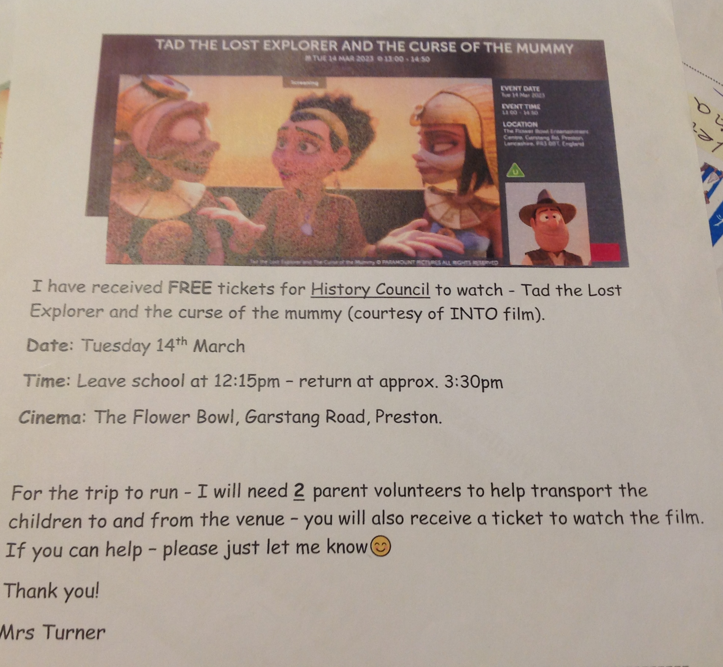
4.2 How does history beyond the classroom enrich the pupils’ experiences?
We History
We treated the History Heroes to a cinema trip.
Next history trip – Shakespeare (Year 5 and 3 Year 4 children) Tuesday 19th March

Slide 8
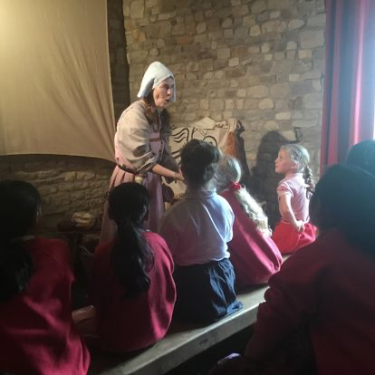
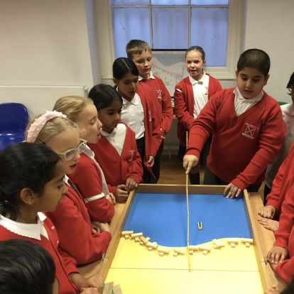
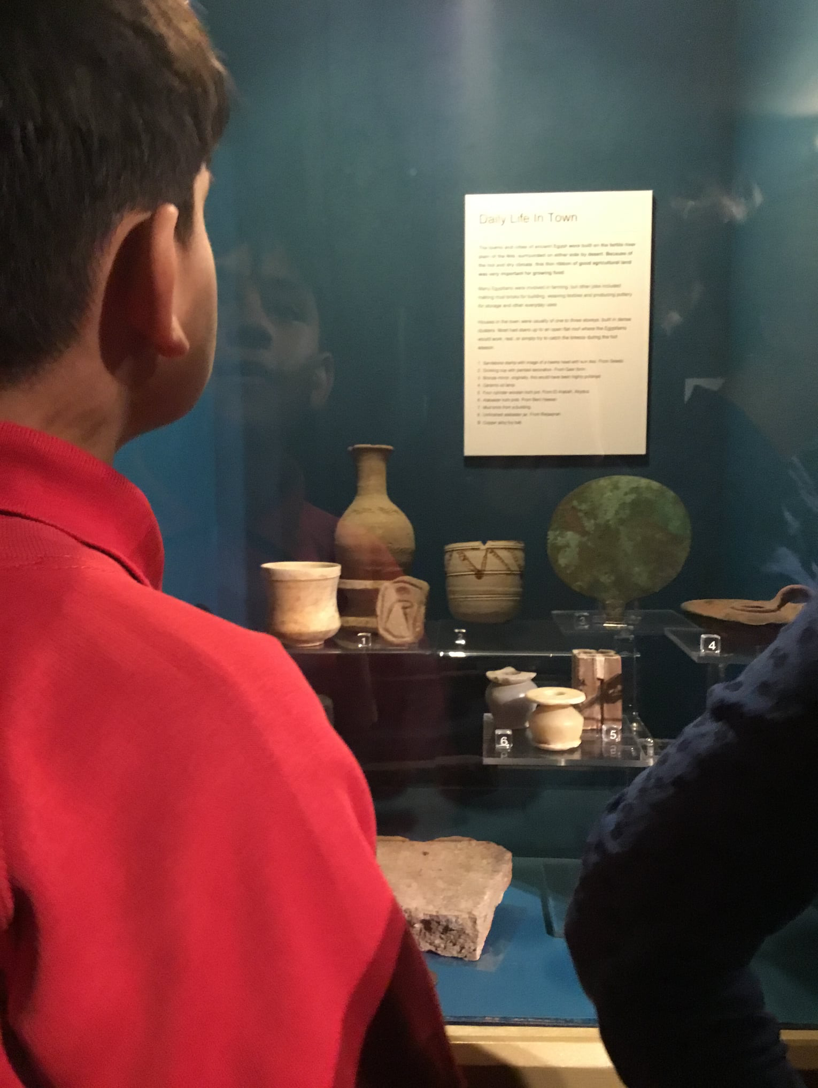
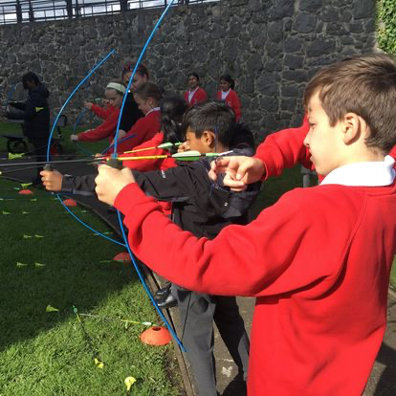
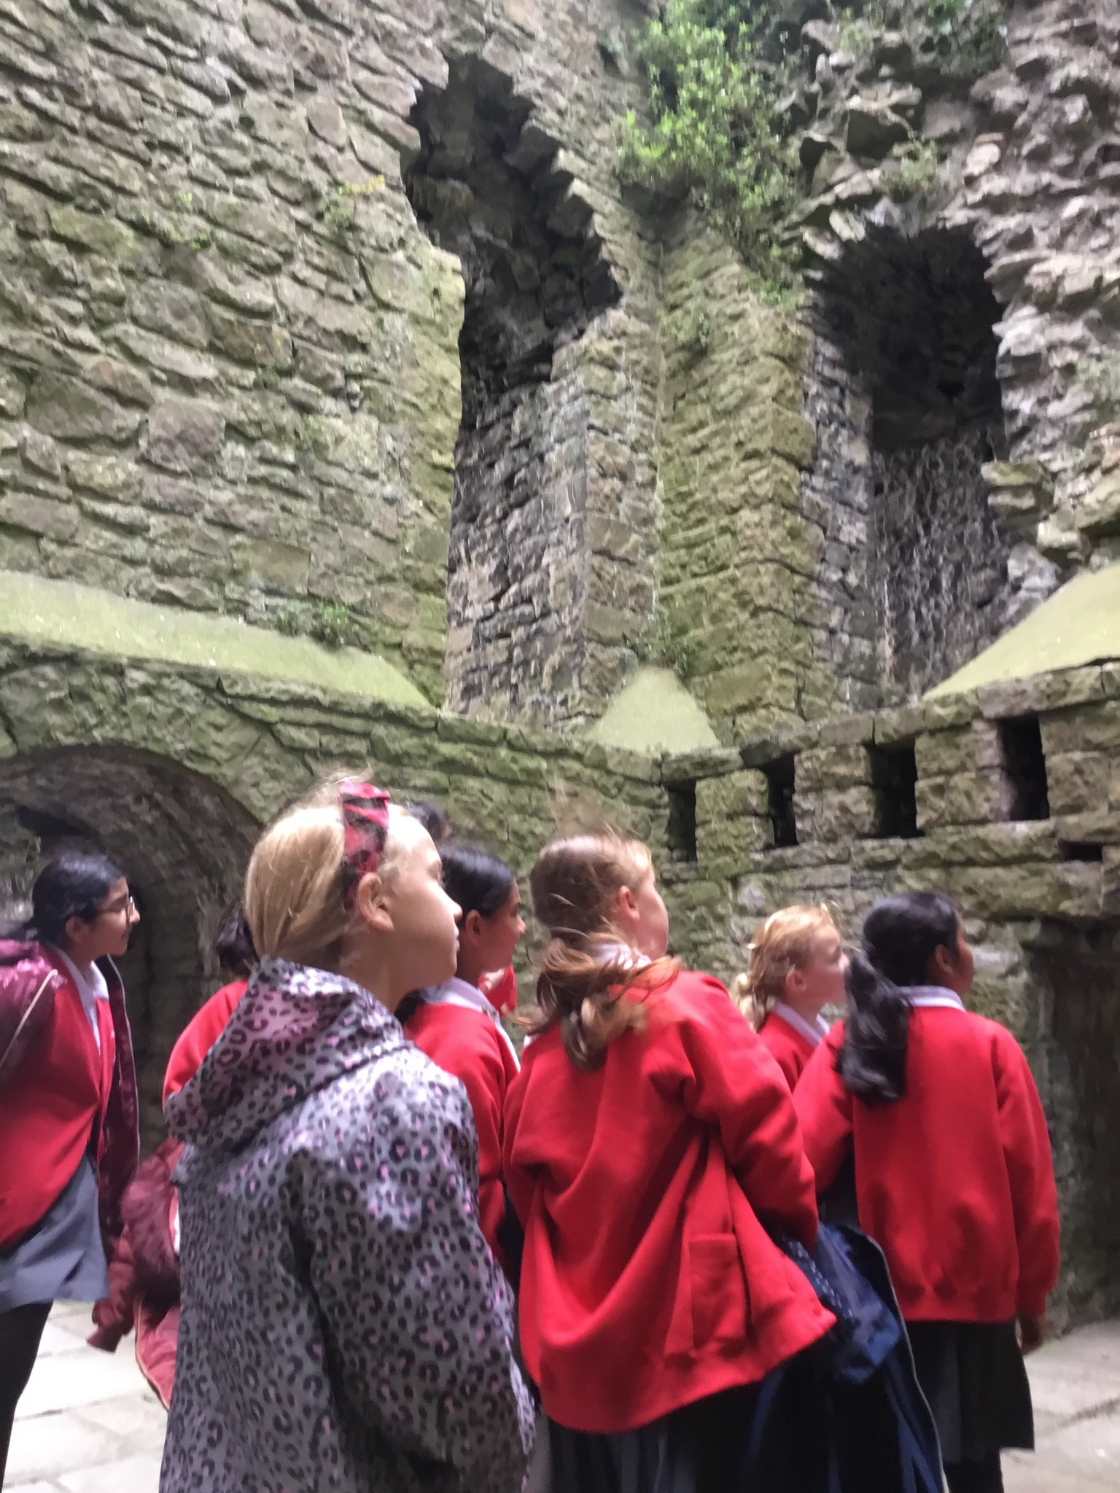
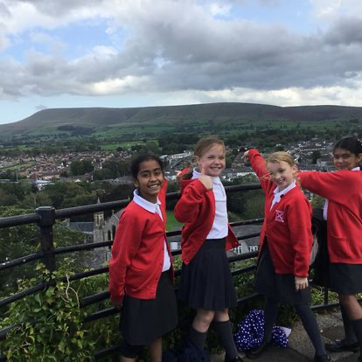
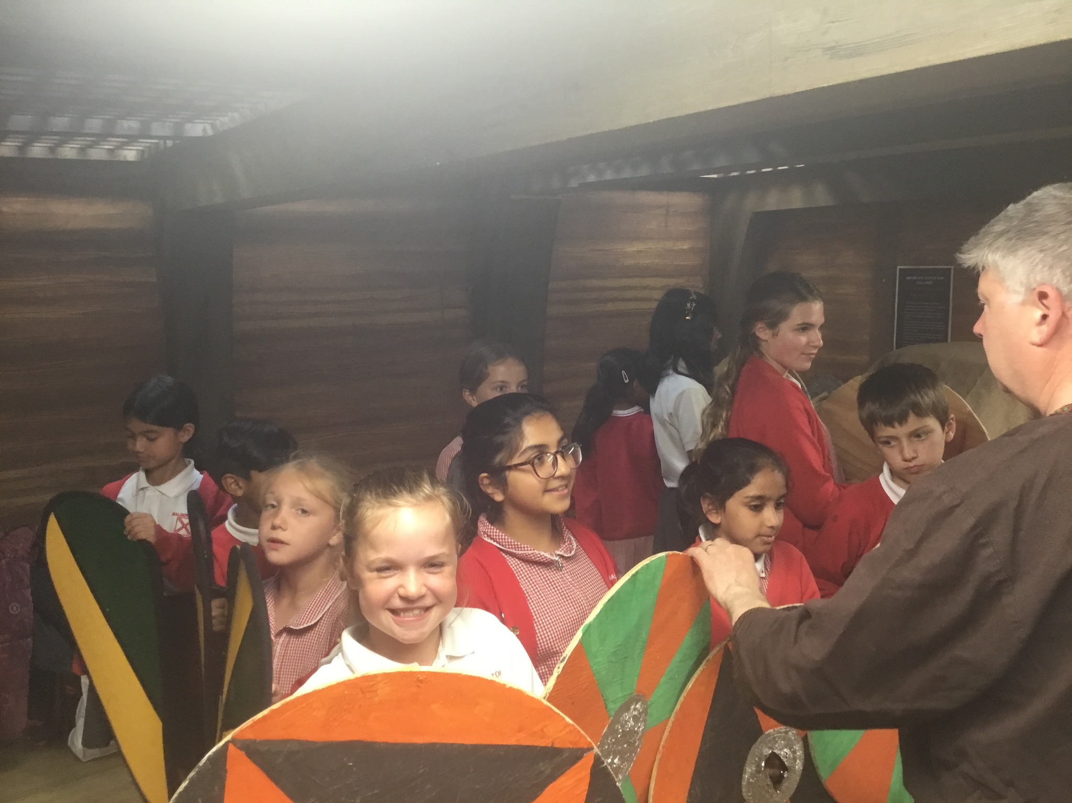
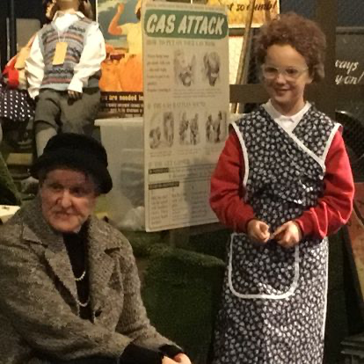
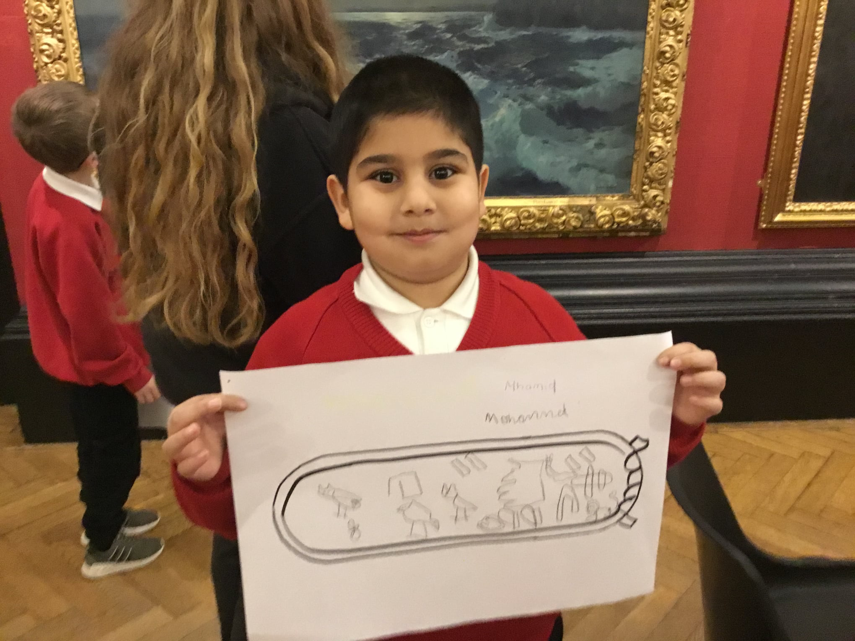
real
informative
fun
Pendle Hill
sources
wow
Goose bumps
Bring history to life
New learning

Slide 9
4.3 How well does history contribute to the school’s online communications?
History enjoys a separate identity on the school’s website, which is used actively to promote the subject and disseminate good practice.
We also publish our new learning on social media

Slide 10
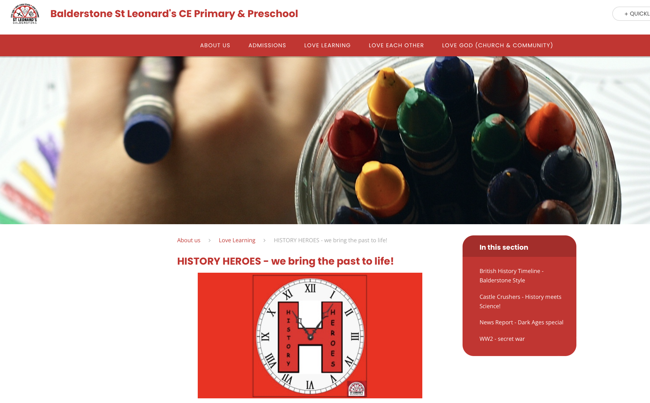
https://www.balderstoneschool.co.uk/page/?title=HISTORY+HEROES+%2D+we+bring+the+past+to+life%21&pid=197

Slide 11
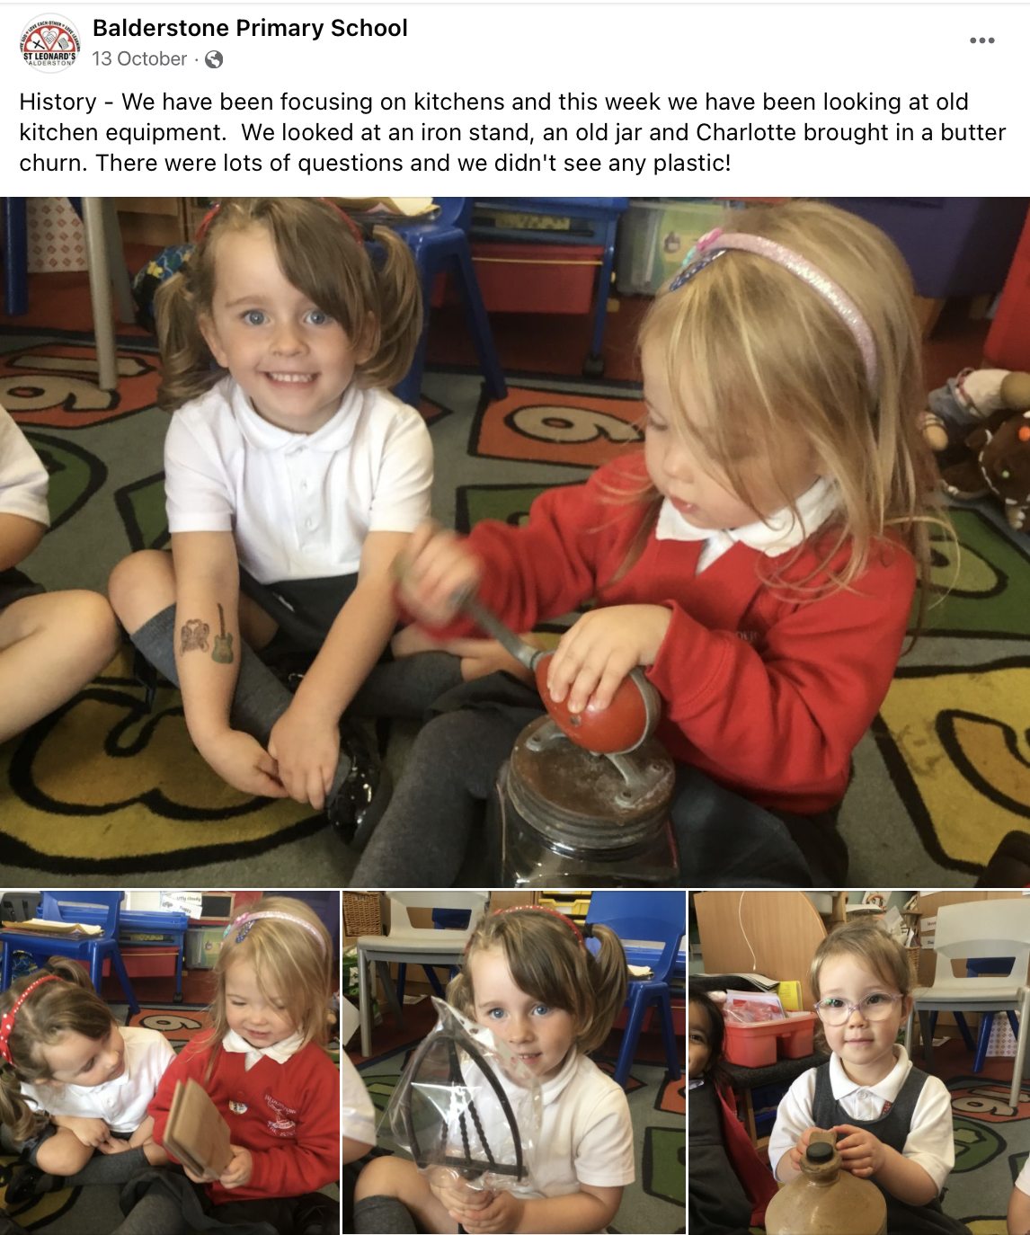
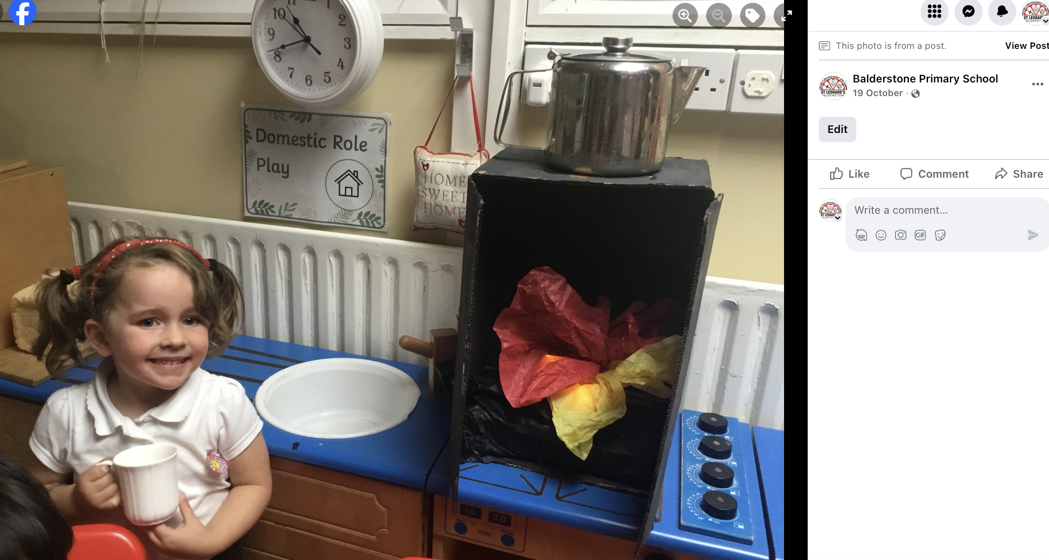
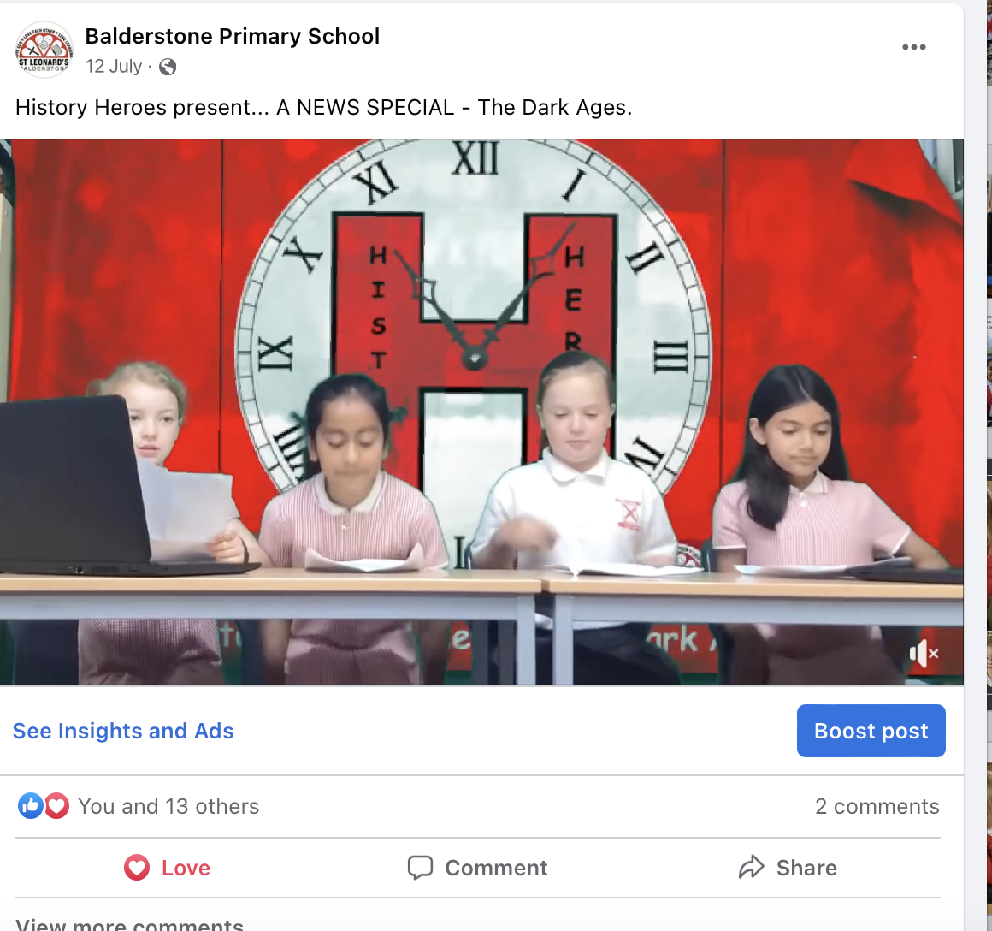
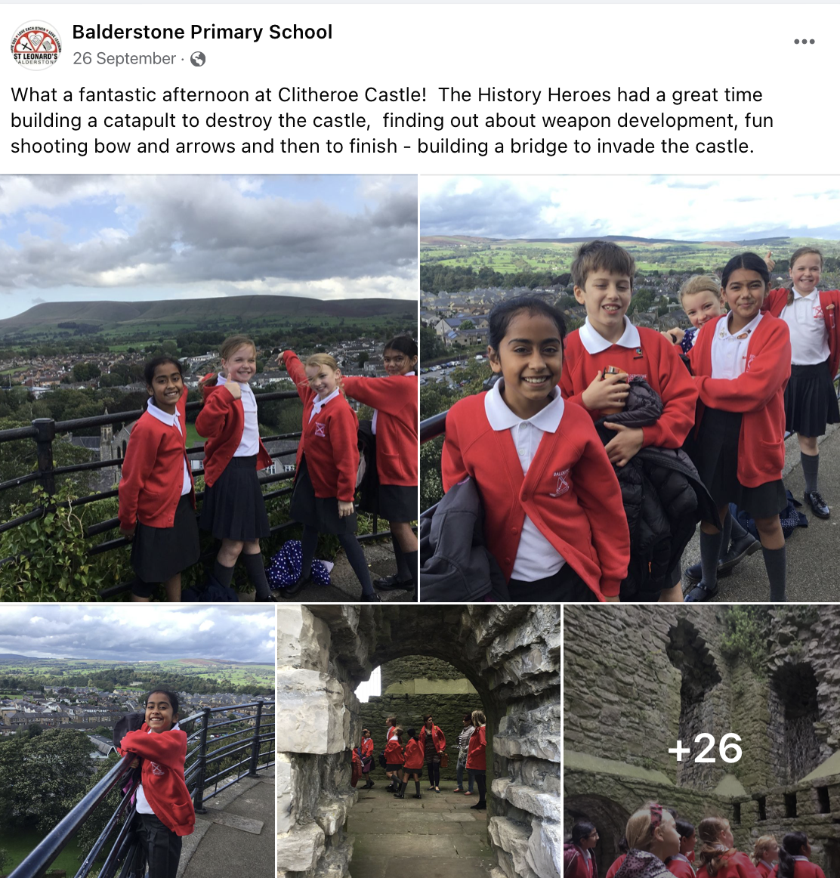
https://www.facebook.com/stleonardsbalderstone

Slide 12
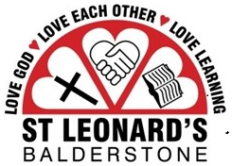
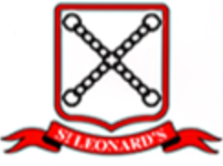
Subject Review: History
Summary
History is vibrant at Balderstone St. Leonards!!!
The teaching of history is receiving a high level of focus at Balderstone St. Leonard’s
All aspects appear to be being considered and there is a refreshing view that more can always be done
Mrs Kate Turner is providing strong leadership that promotes continuous improvement
There is a real ‘buzz’ about history at the school, amongst both teachers and students, that creates excitement and supports learning
Best of all – the students are extremely engaged

Slide 13
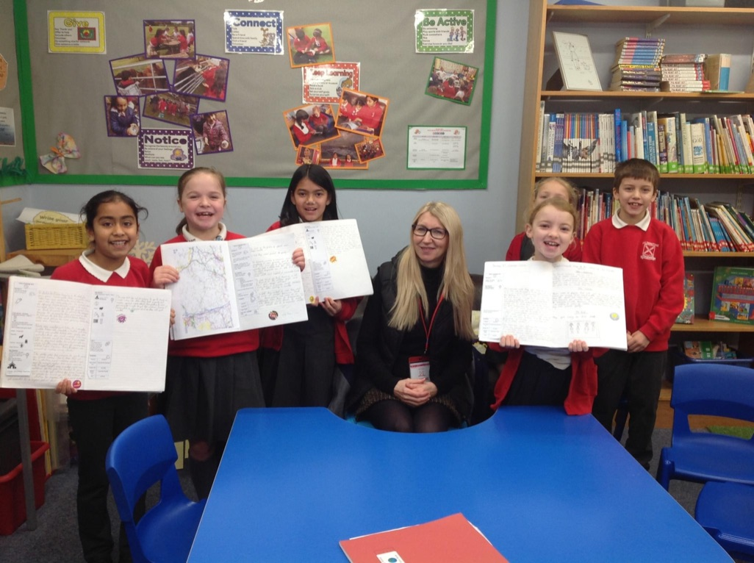
Thank you for taking time to look through our History Quality Mark Presentations

